Slide 1
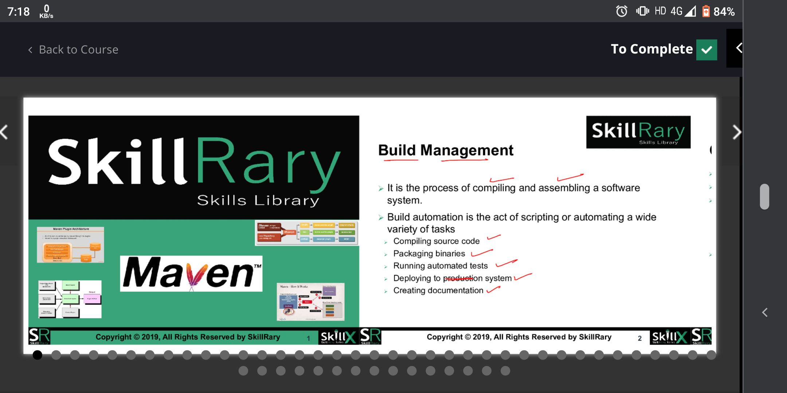

Slide 2
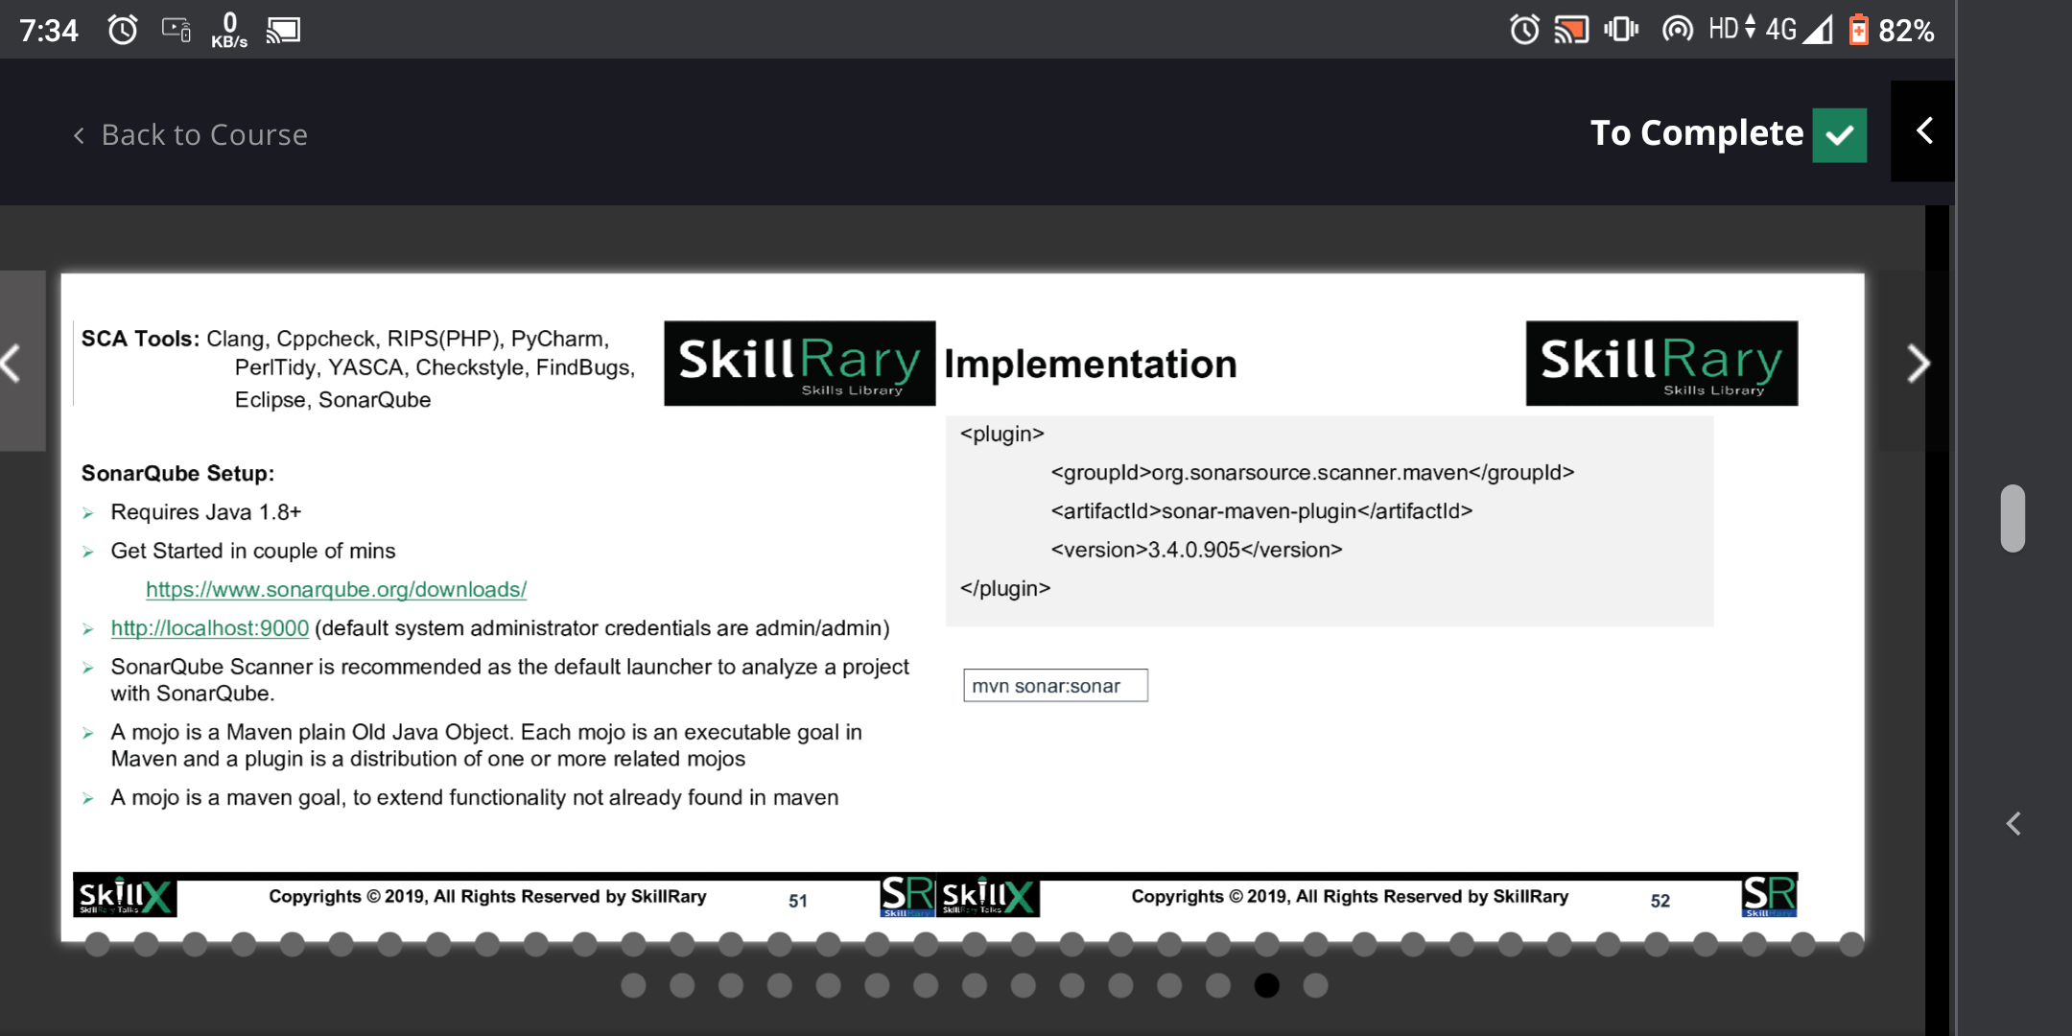

Slide 3
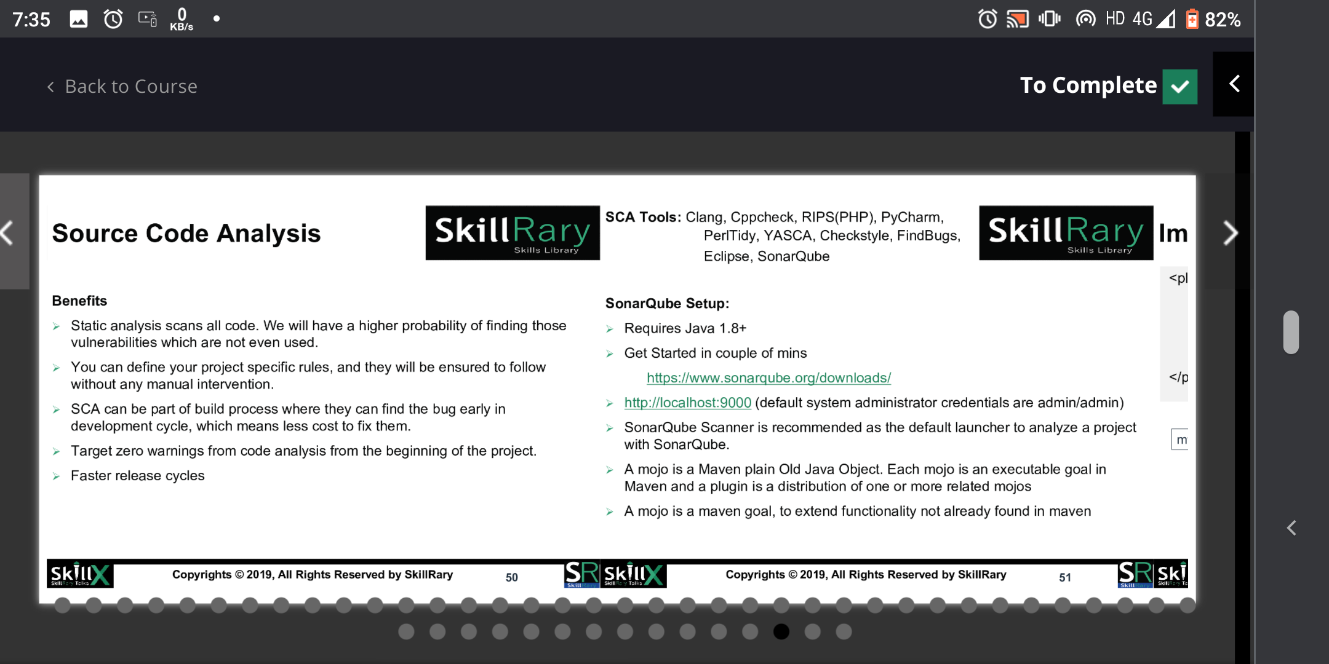

Slide 4
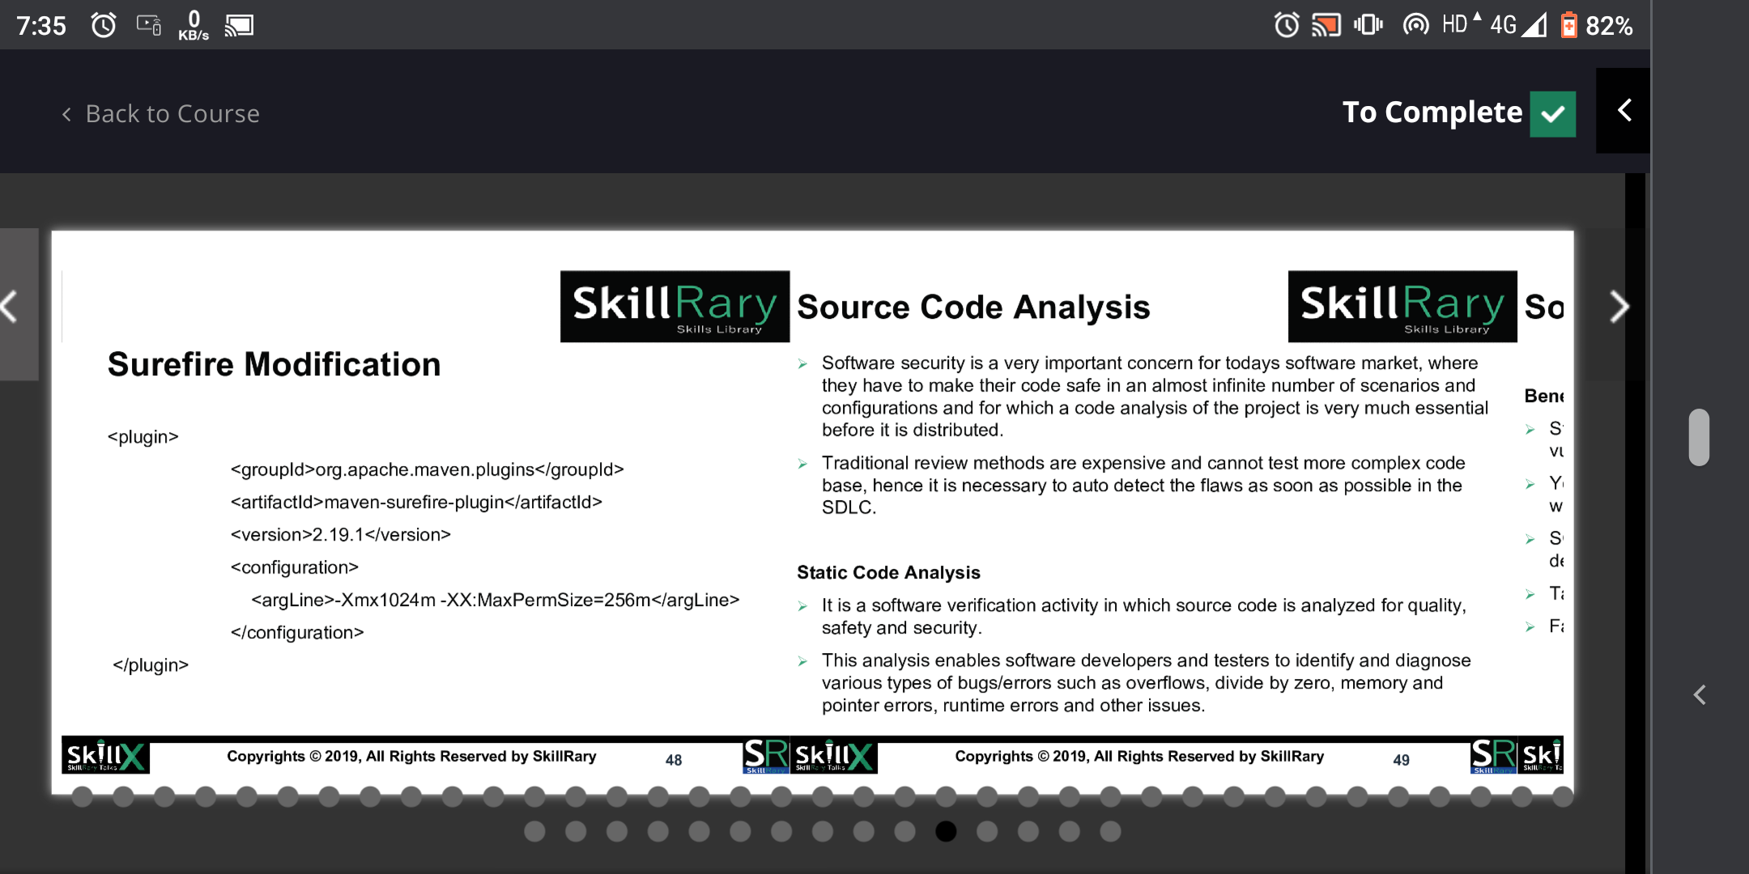

Slide 5
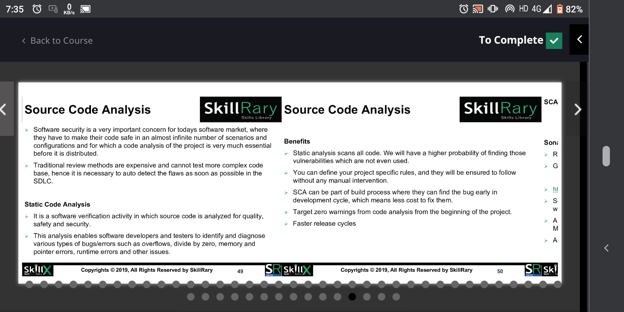

Slide 6
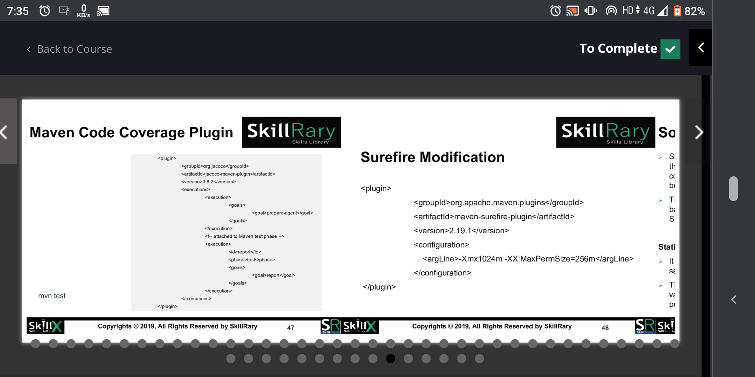

Slide 7
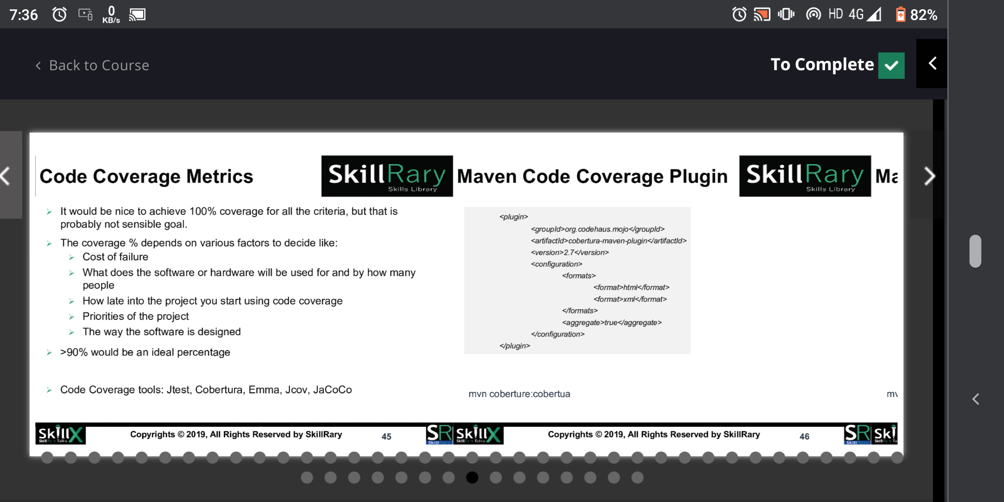

Slide 8
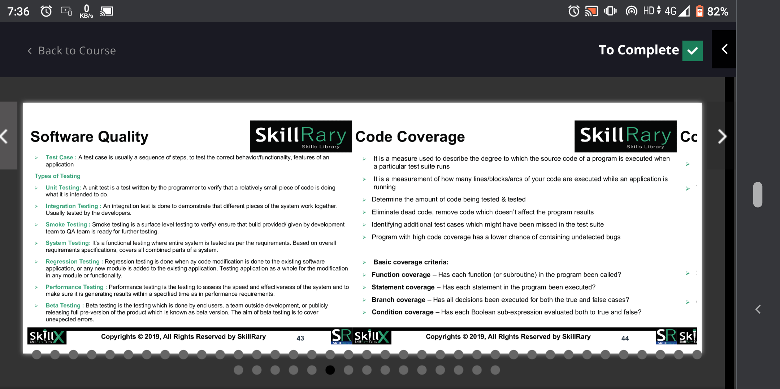

Slide 9
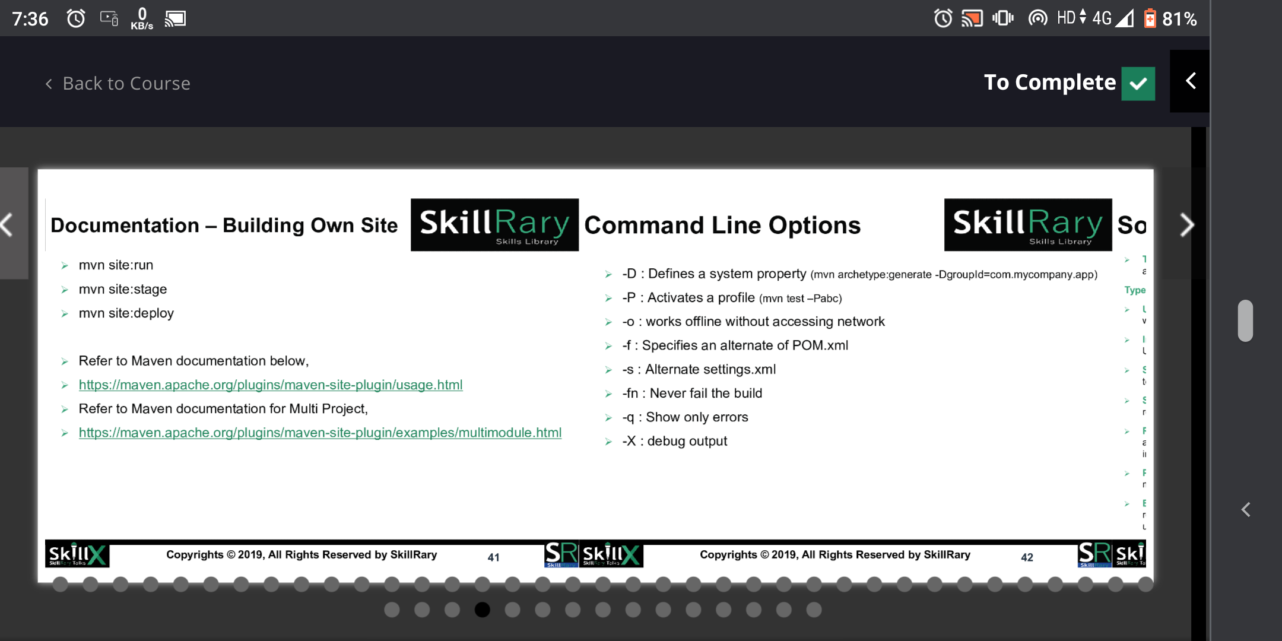

Slide 10
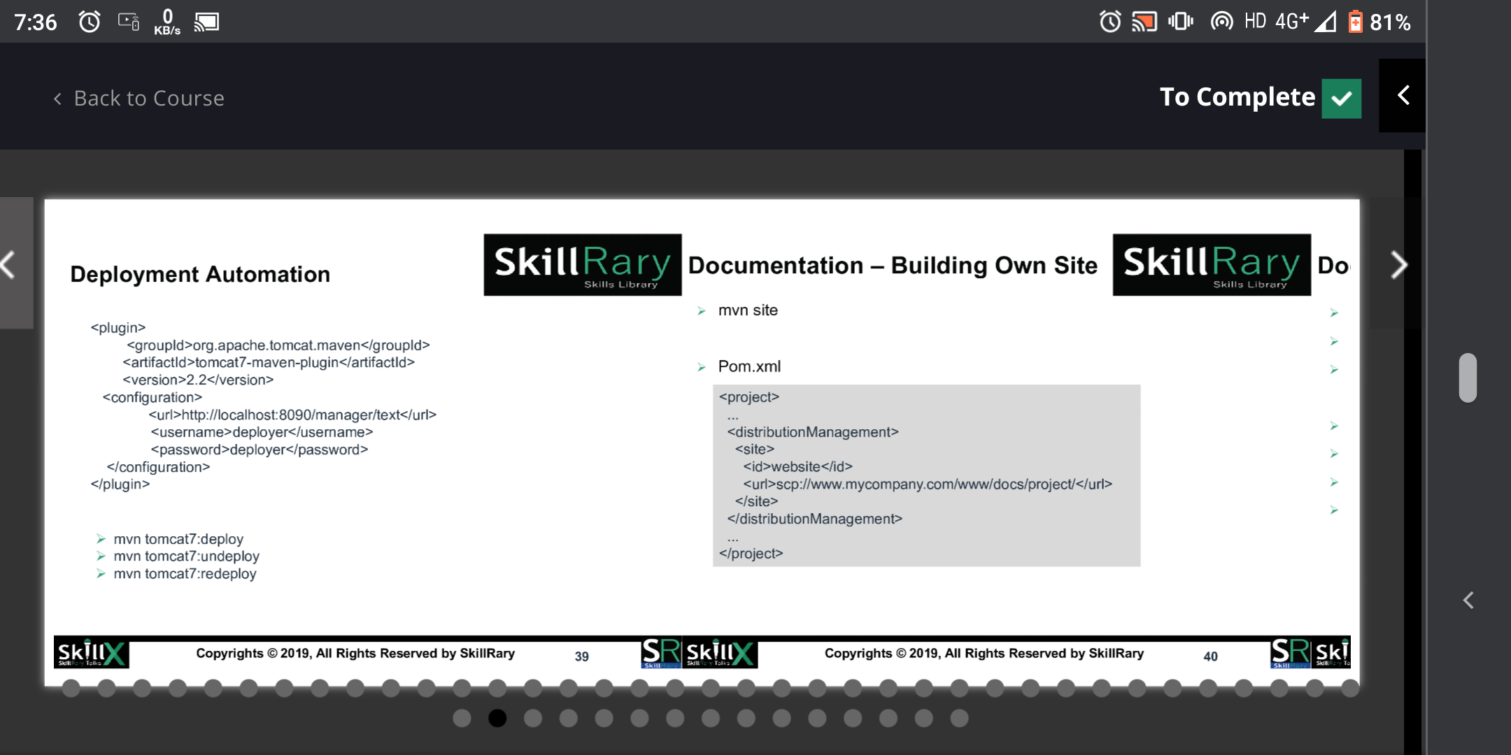

Slide 11
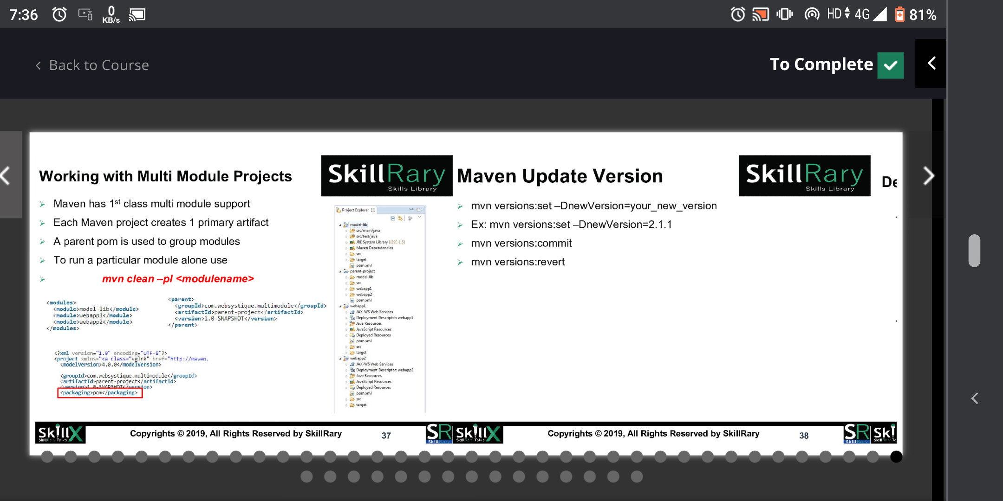

Slide 12
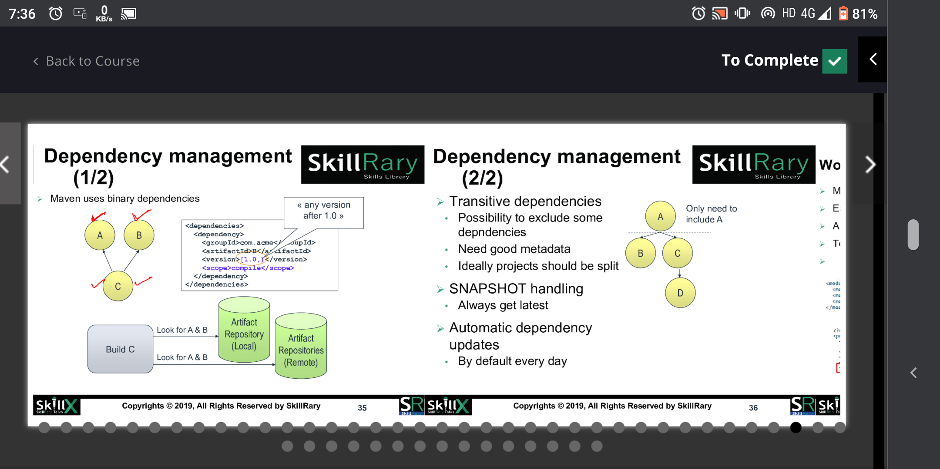

Slide 13
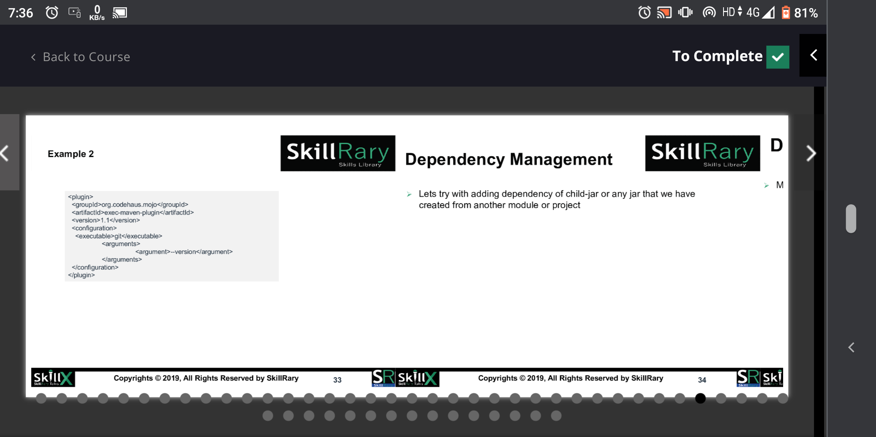

Slide 14
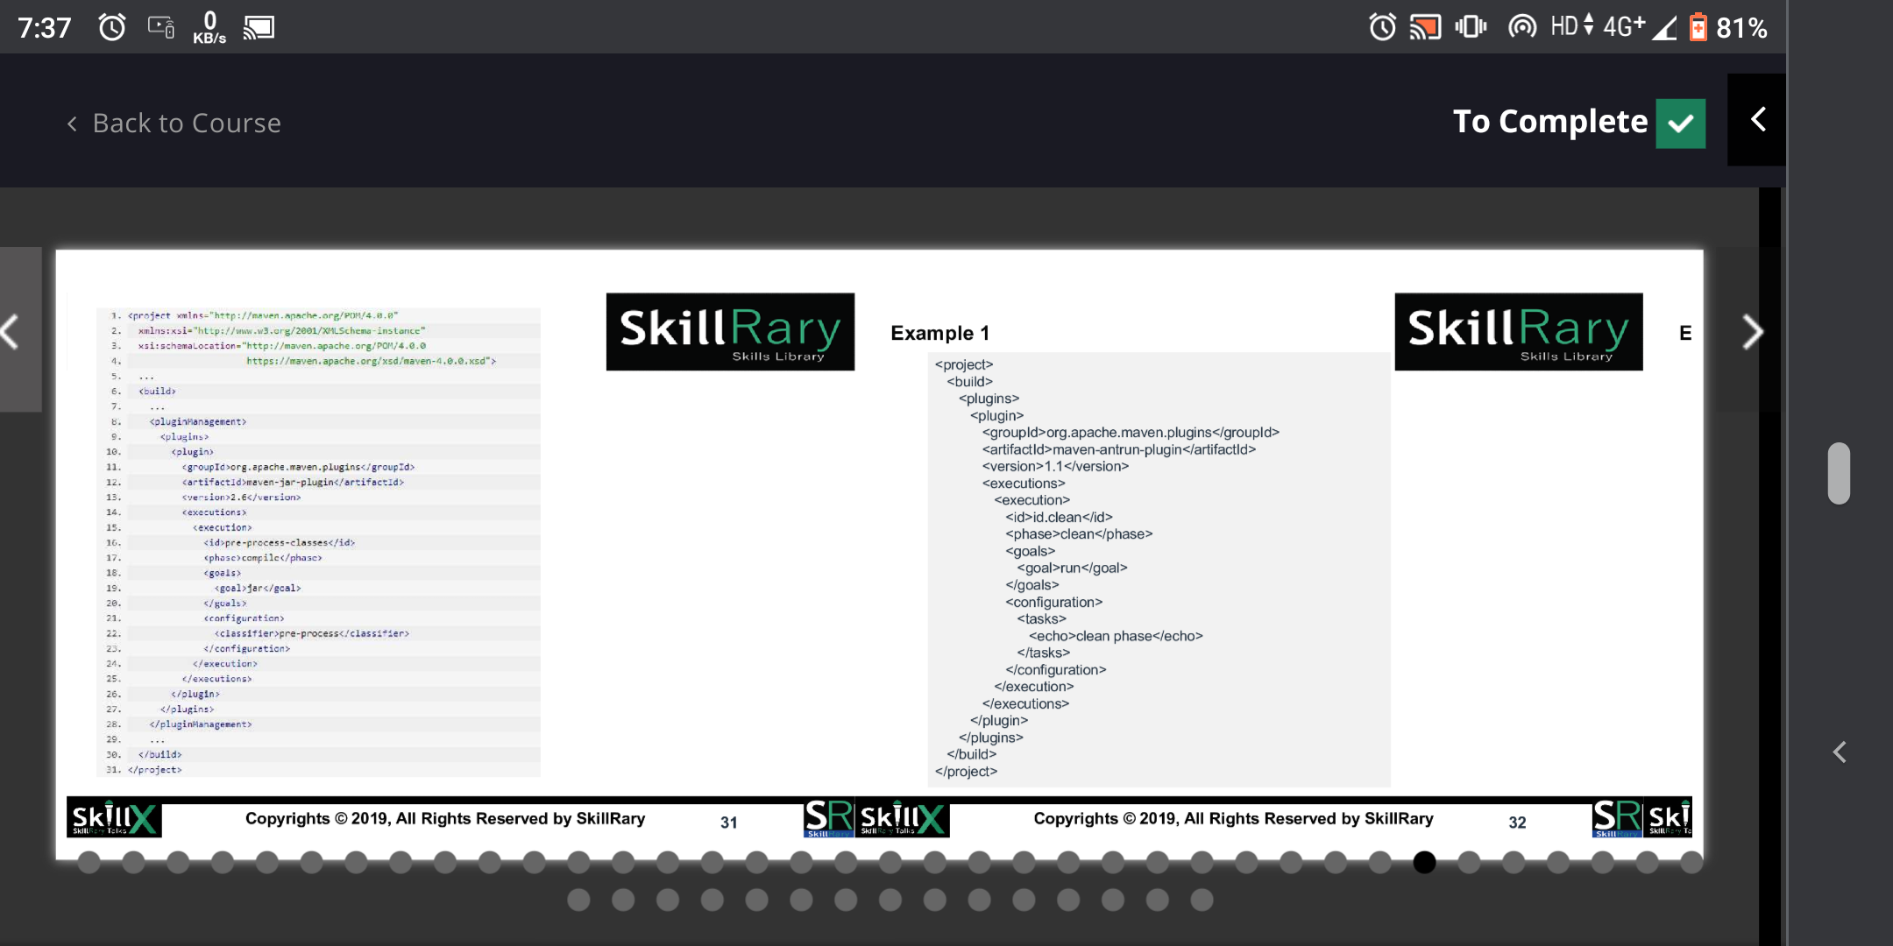

Slide 15
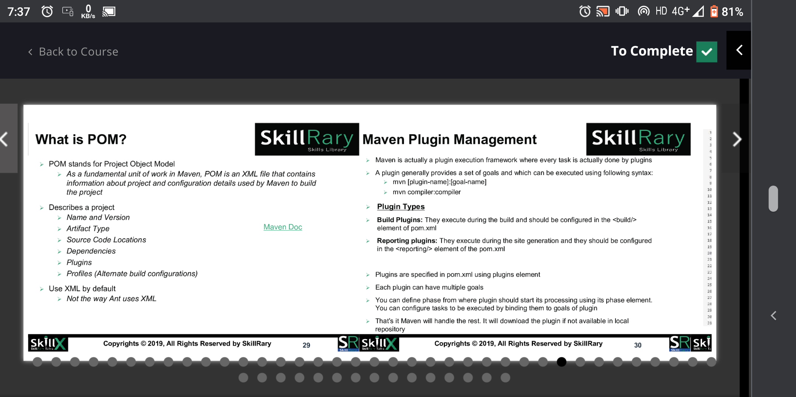

Slide 16
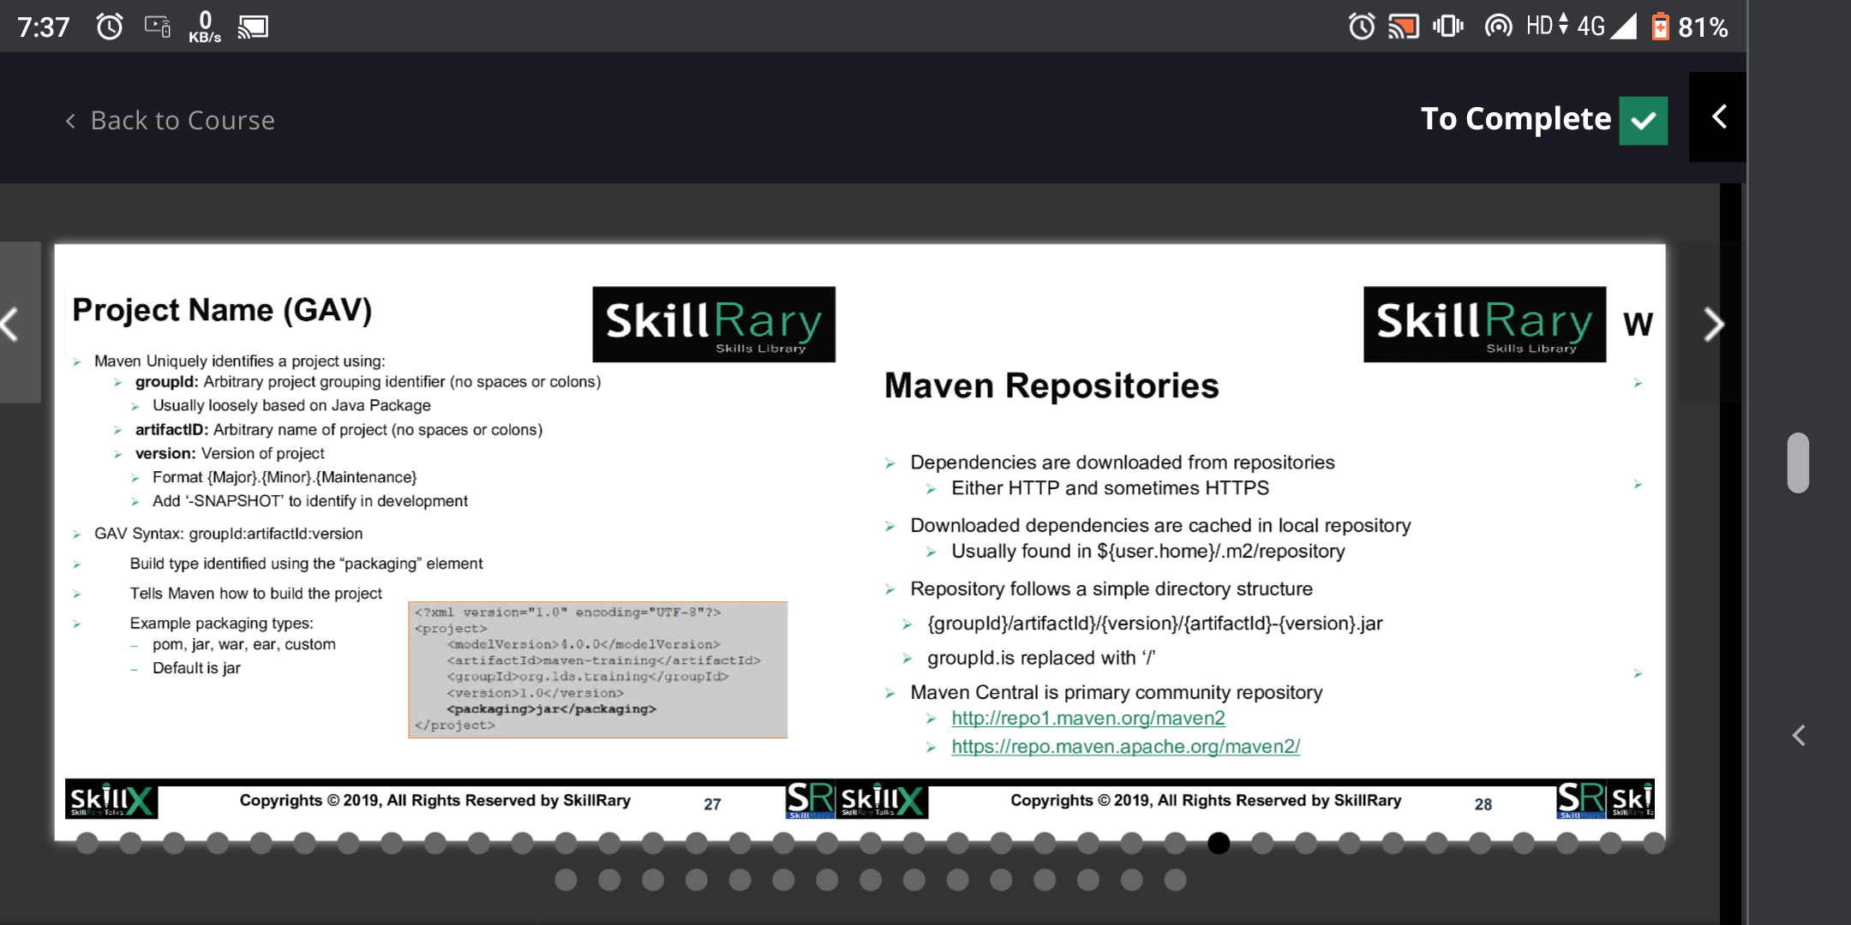

Slide 17
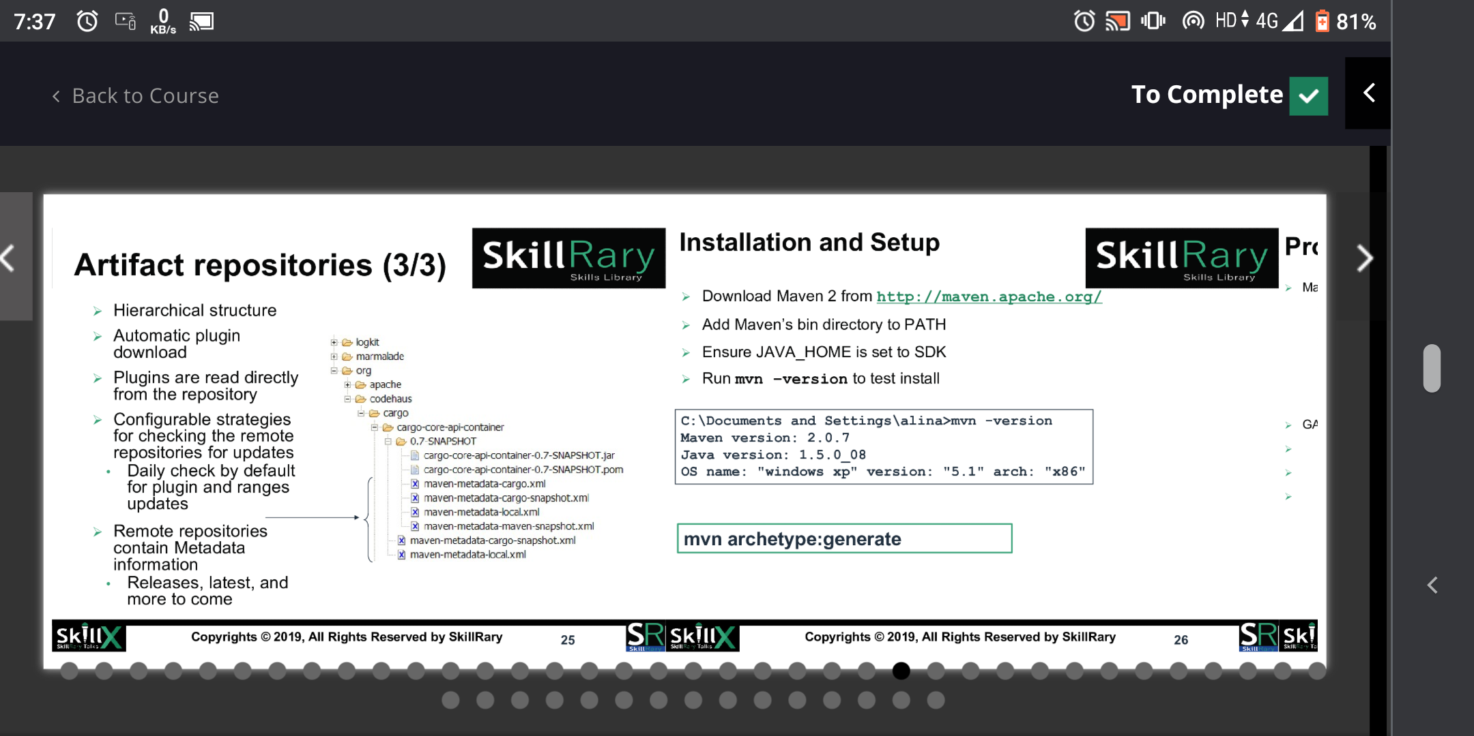

Slide 18
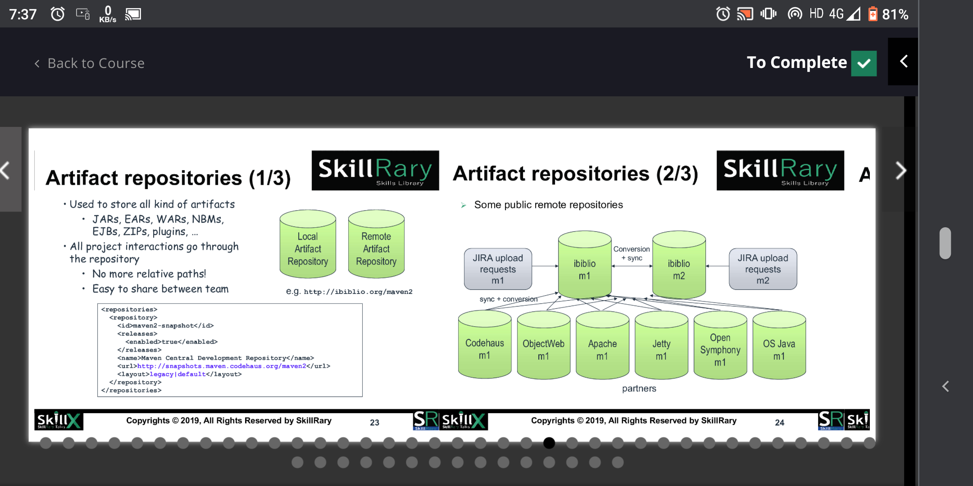

Slide 19
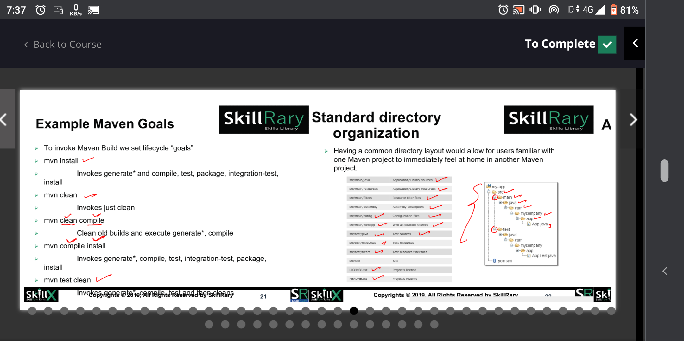

Slide 20
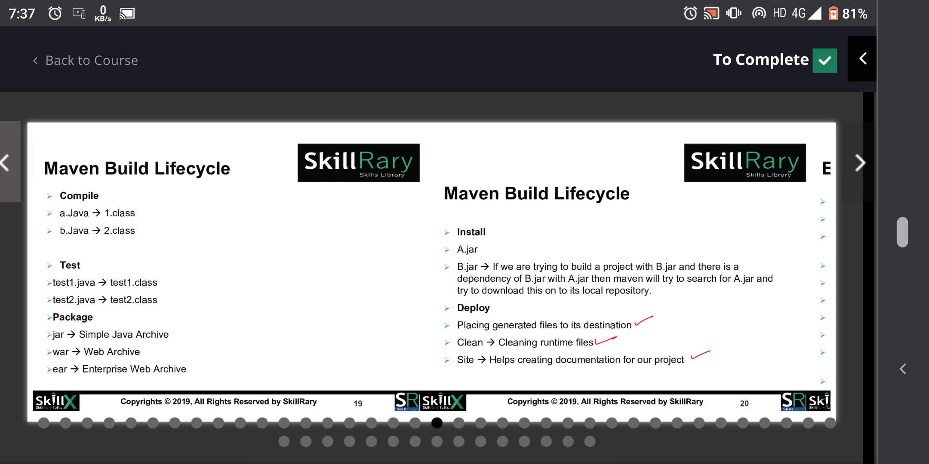

Slide 21
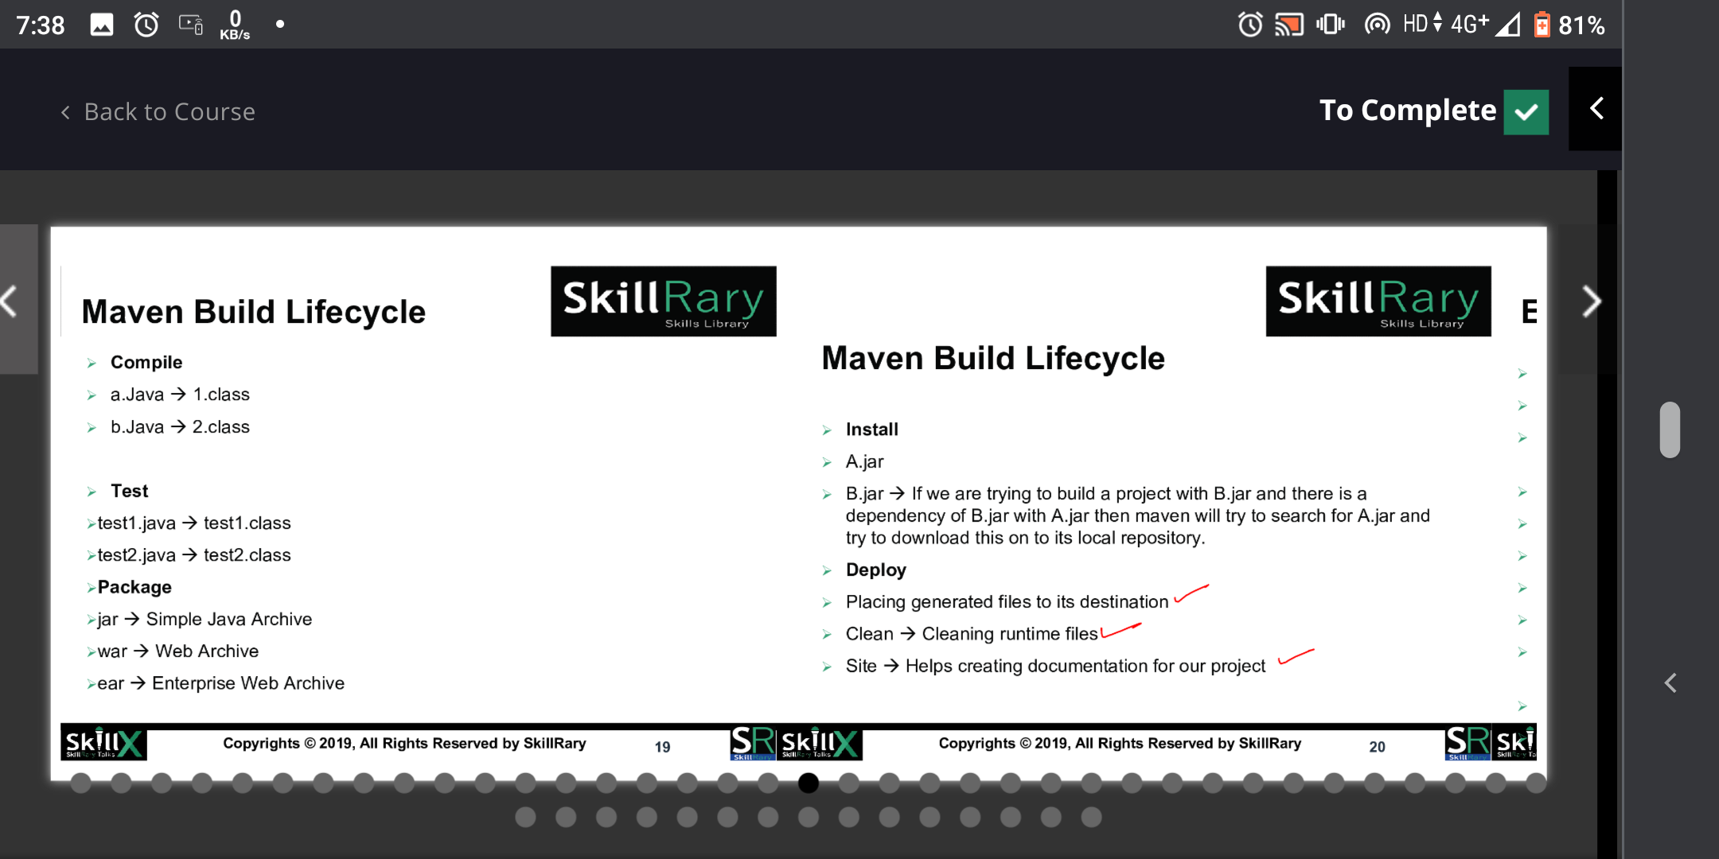

Slide 22
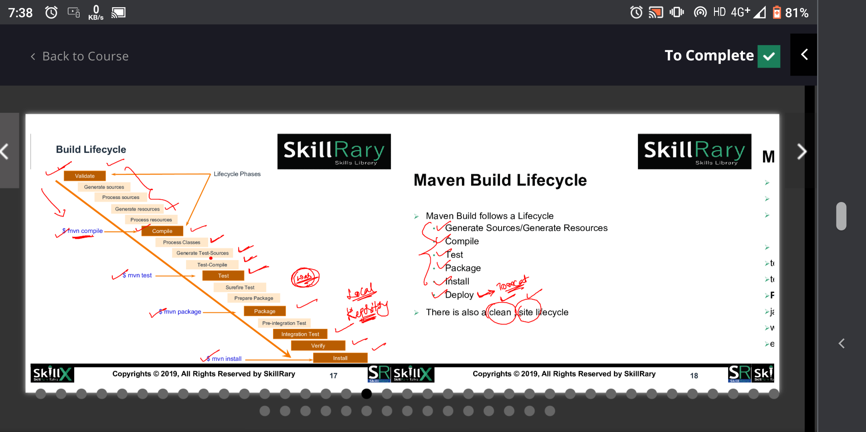

Slide 23
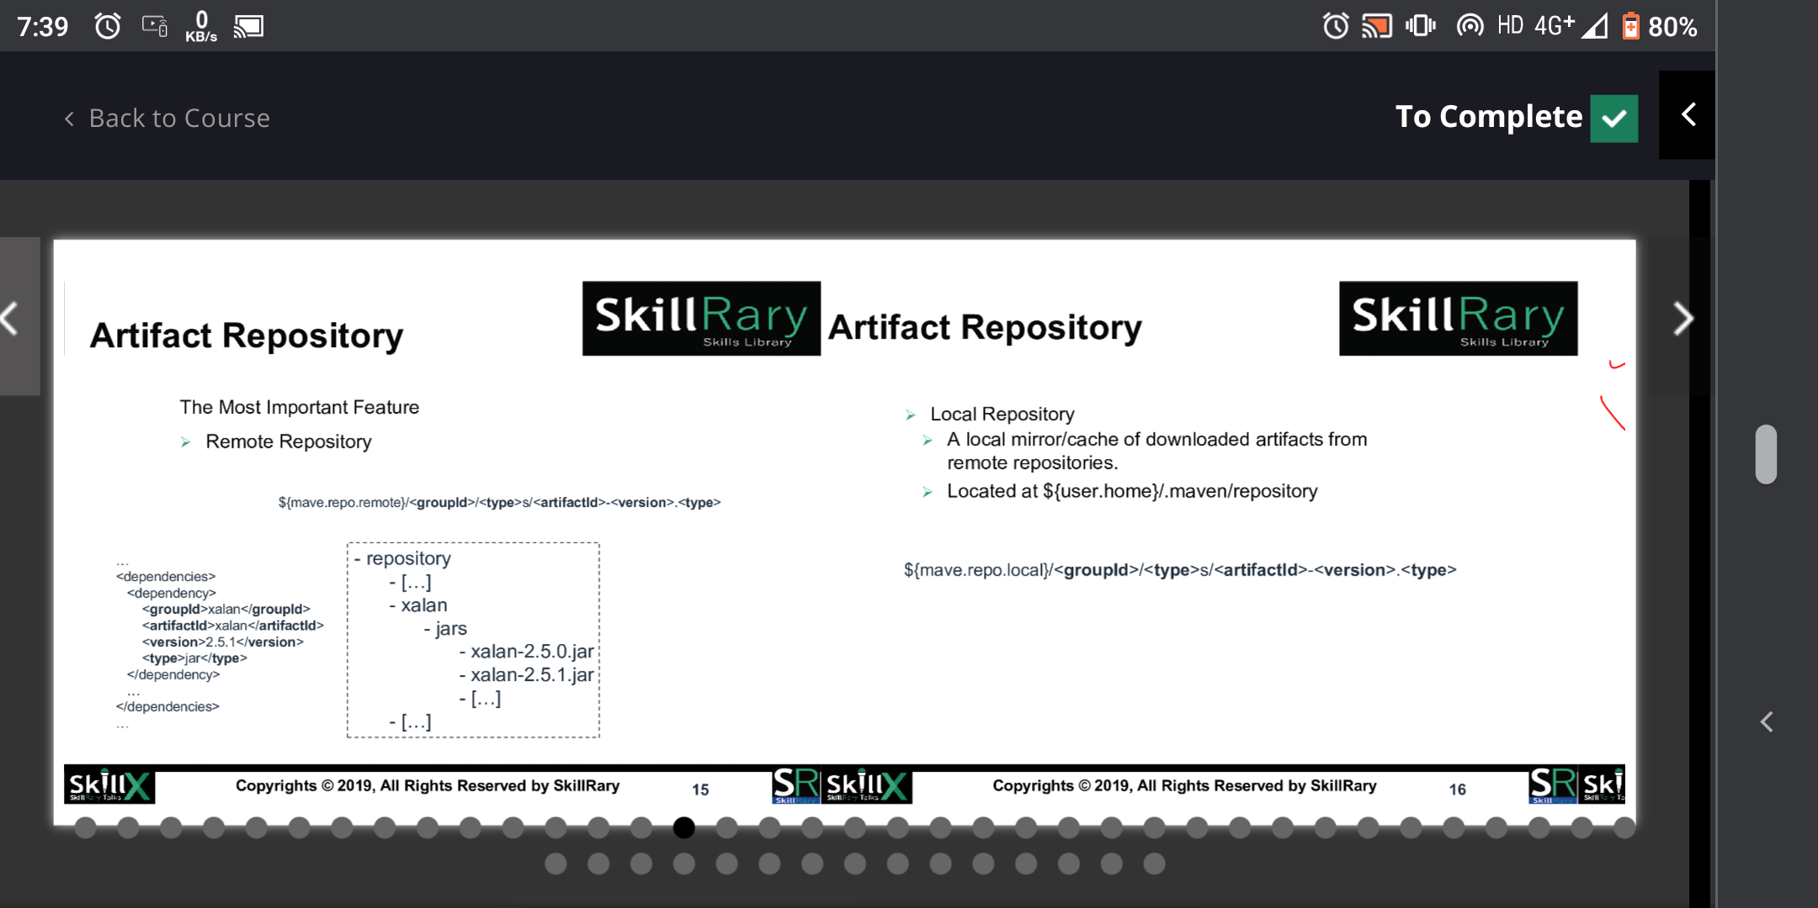

Slide 24
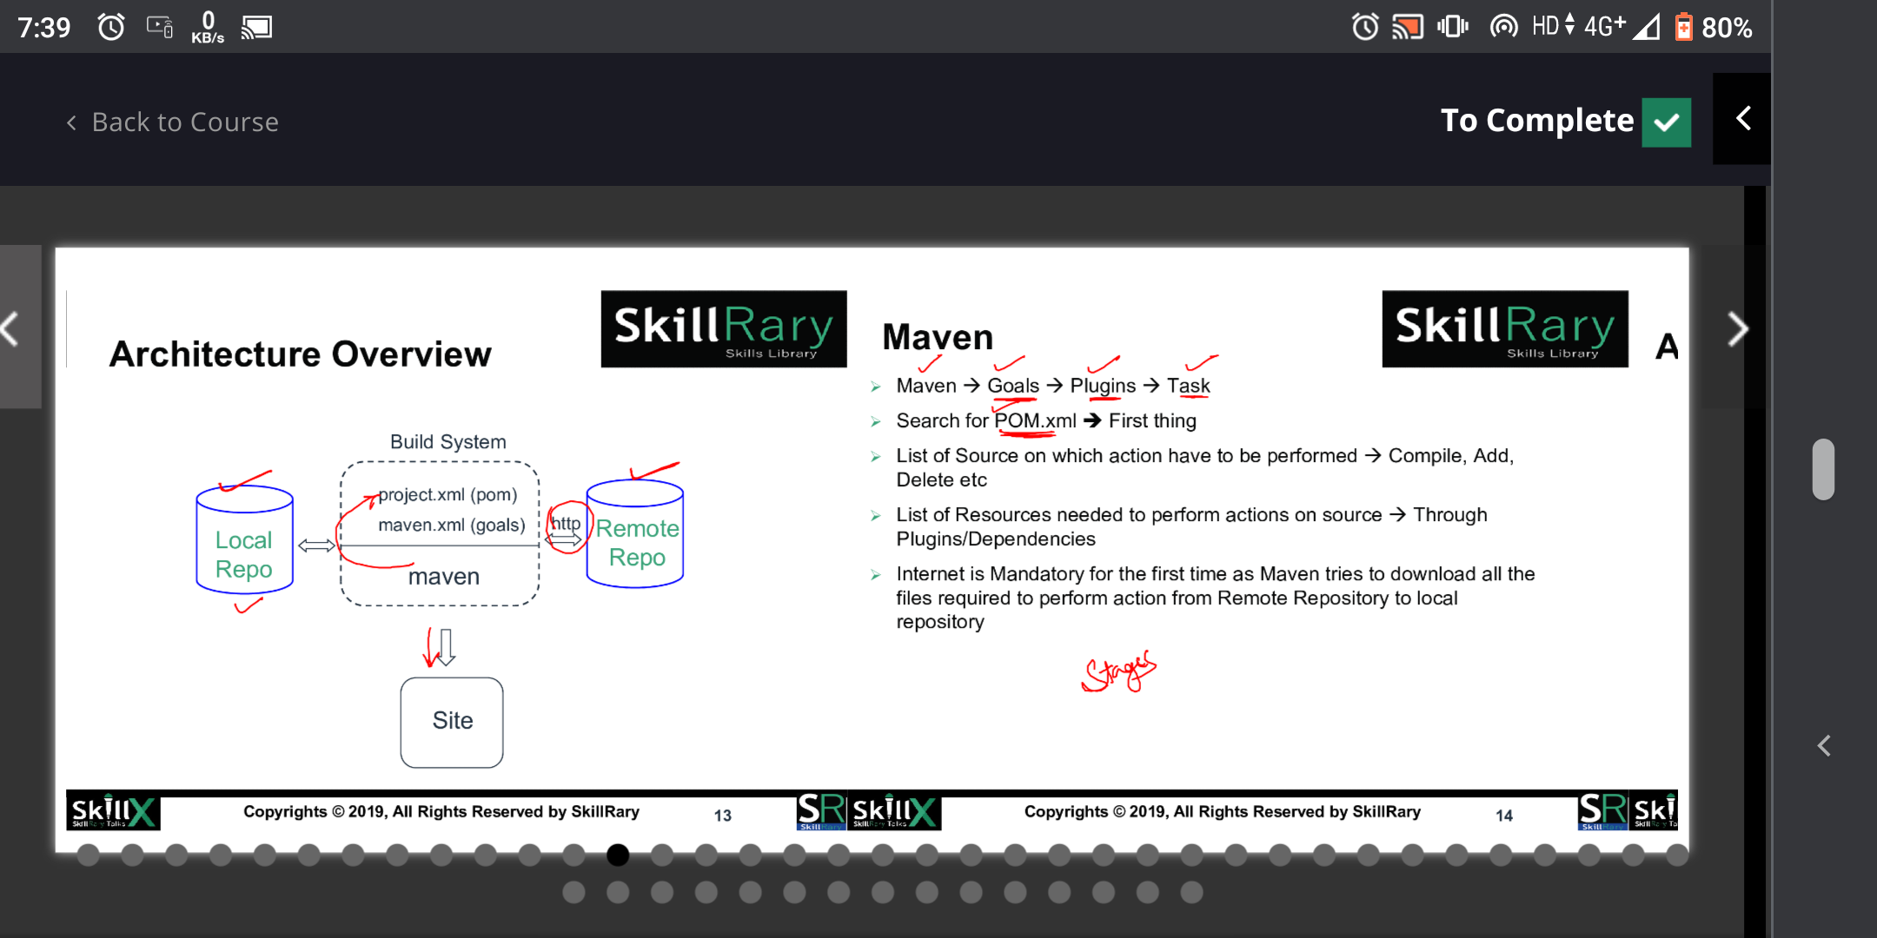

Slide 25
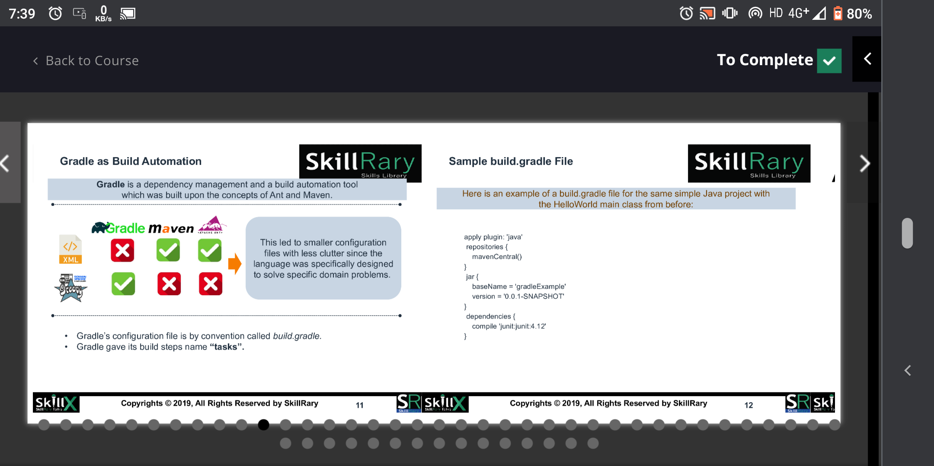

Slide 26
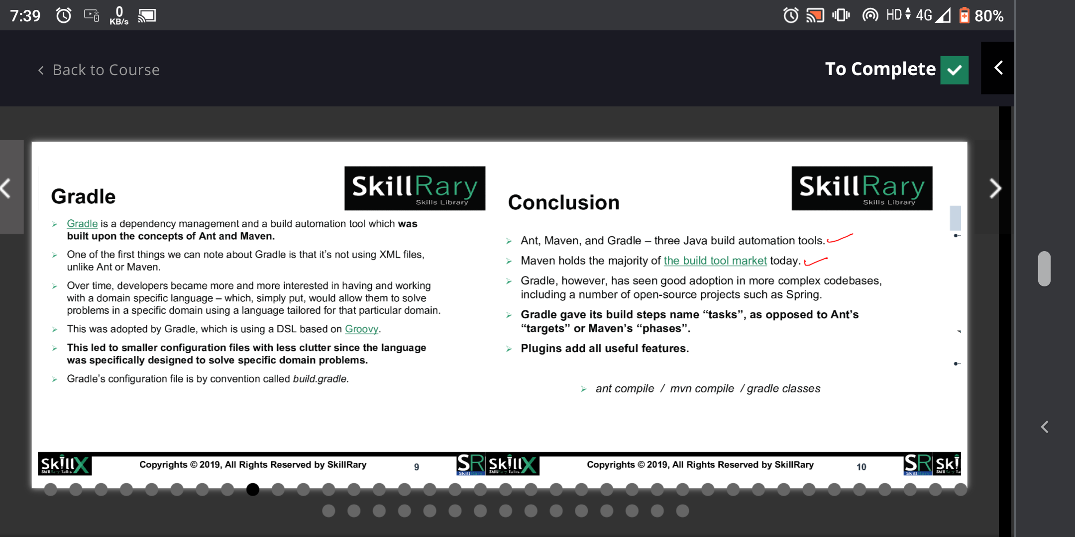

Slide 27
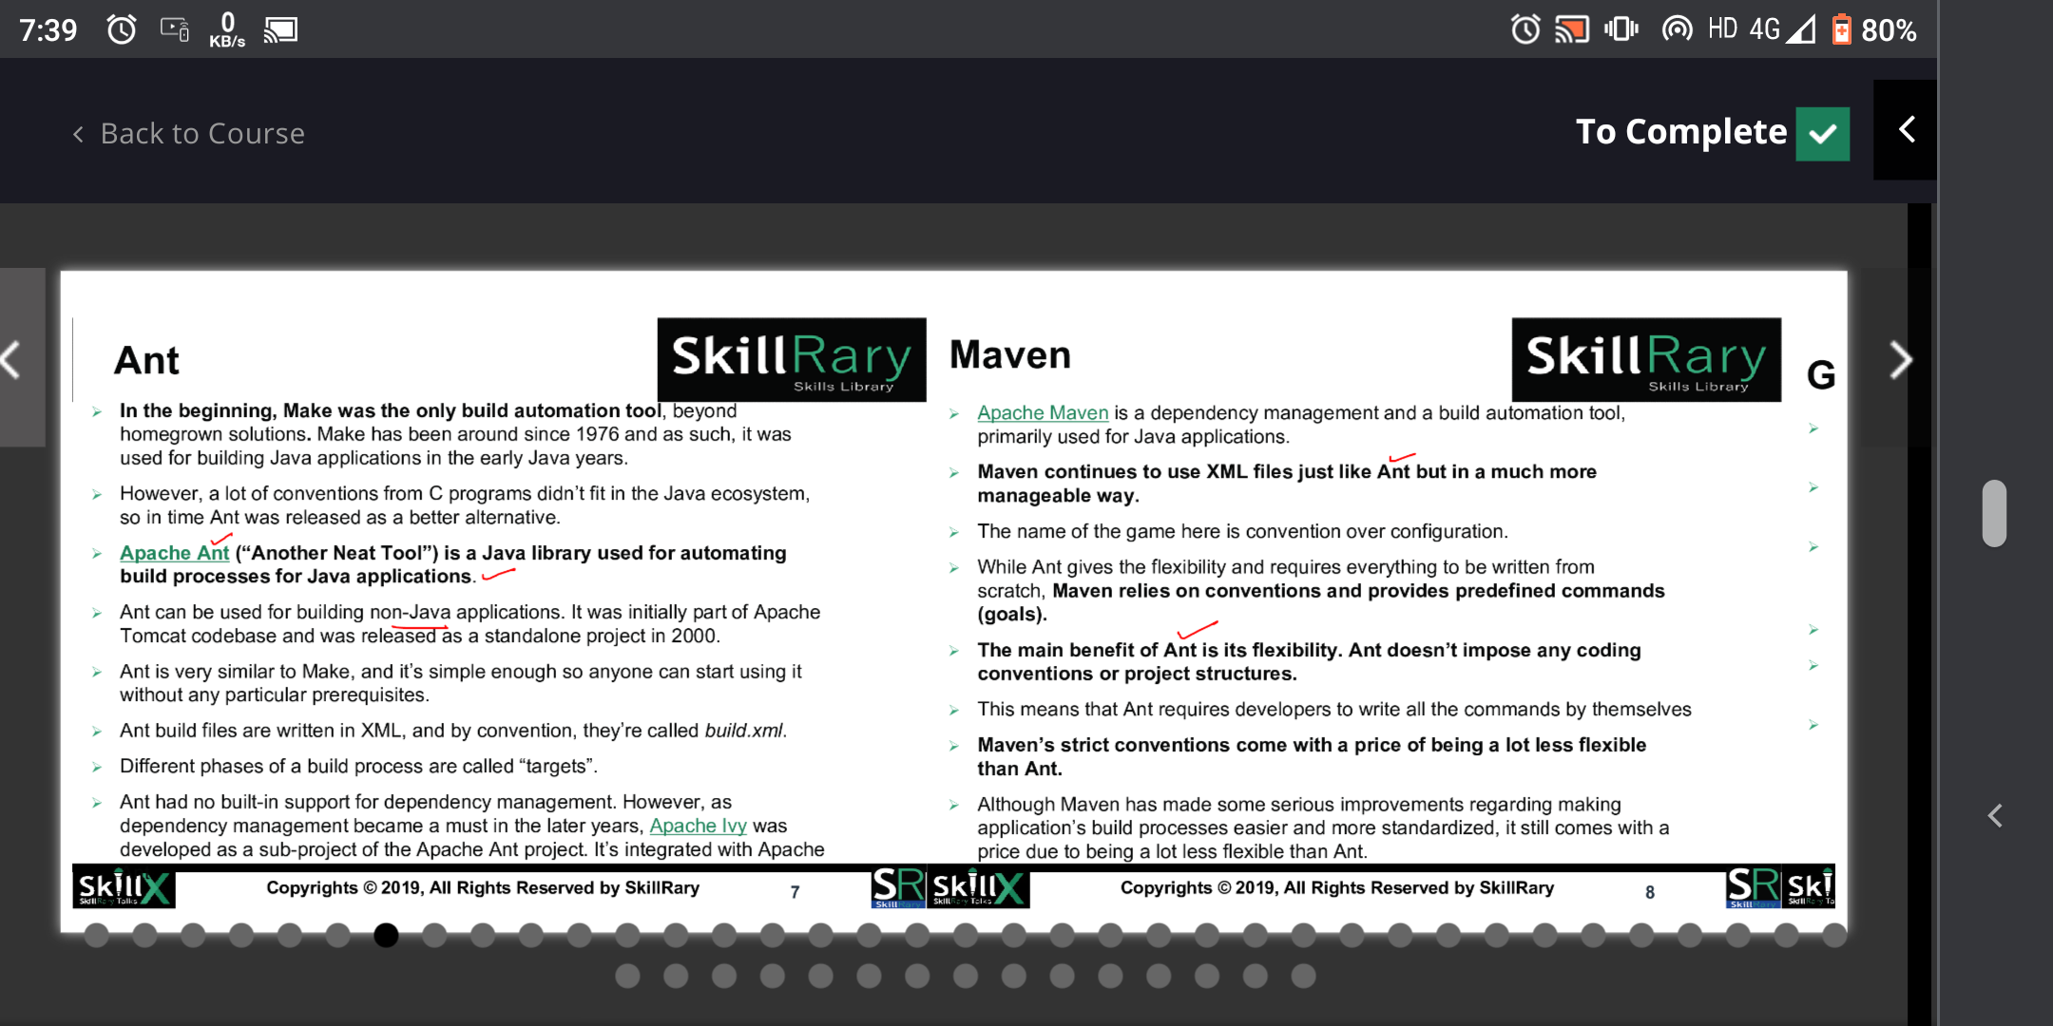

Slide 28
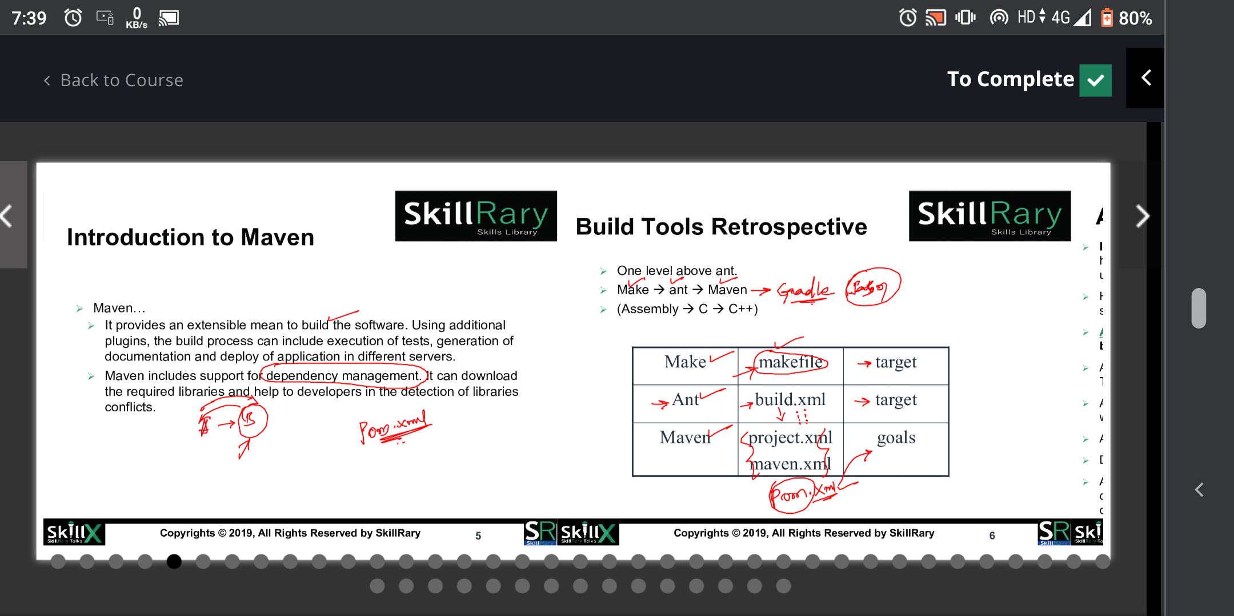

Slide 29
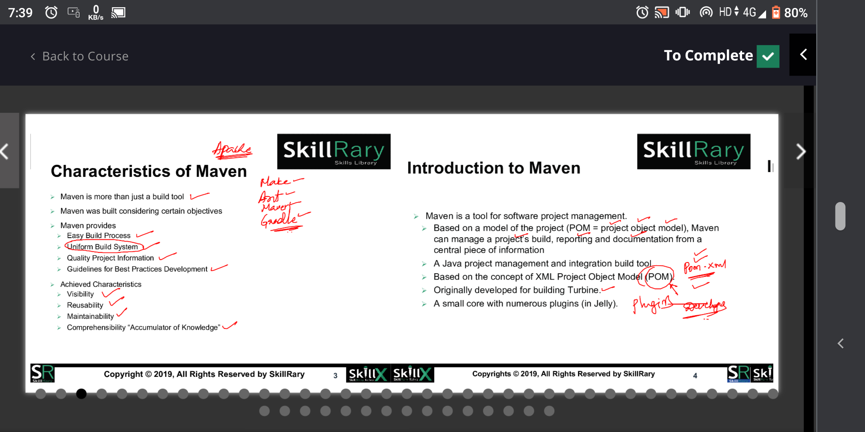

Slide 30
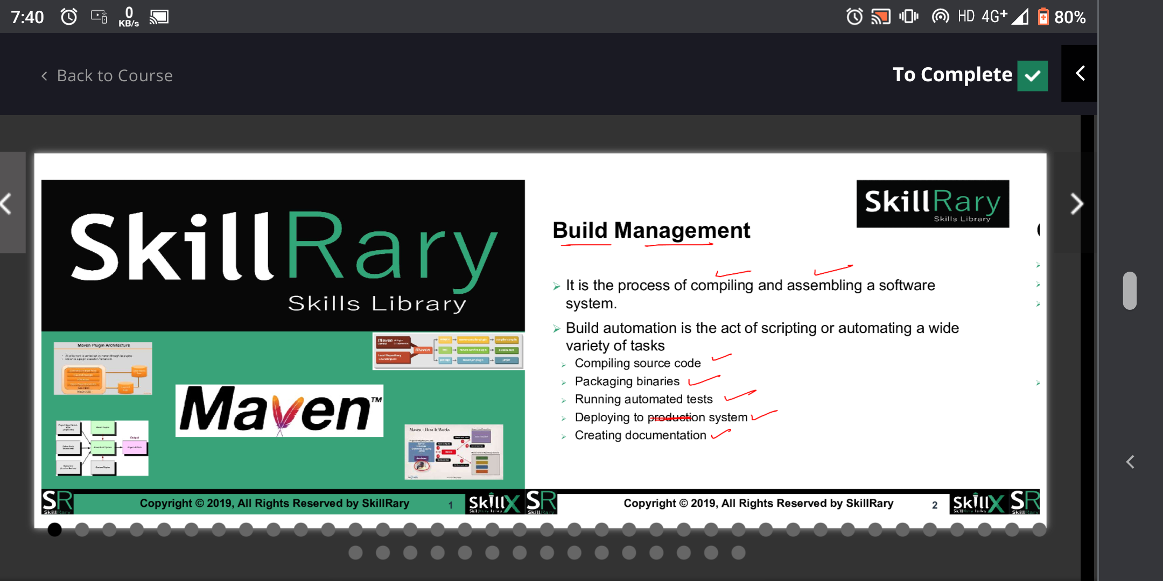

Slide 31
maven: is a dependancy management and a build
automation tool primarly used for java aplication
set PATH="c:\program files\apache-maven-3.8.1\bin";%PATH%
pre-requisite:
jdk
maven package from internet
set environment variable path MAVEN_HOME

Slide 32
maven will helps us to do below:
-------------------------------
configure
downloading the src code
initialization
compile
package
unit test
deployment
document
reports
clean
dependancy management
-------------------------------

Slide 33
maven can do variety of tasks
1. compiling source code
2. packaging binaries
3. running automated test
4. deploying to system
5. creating documents
based on pom(project object model) maven can manage
project build ,reporting and documentation
java build automation tools:
1.Ant
2.maven
3.gradle

Slide 34
mvn help:effective-pom
continous integration and devops tools setup and tips
https://www.cidevops.com/
https://maven.apache.org/pom.html
how to run maven in cmd
cmd---> mvn archetype:generate
generated project in C:\Users\Alex\dev
portno: 8888
mvn compile
mvn test
mvn package
mvn install
mvn clean
mvn site

Slide 35
TO DEPLOY PROJECT FROM MAVEN TO TOMCAT USE BELOW COMMAMDS
mvn tomcat7:deploy
mvn tomcat7:undeploy
mvn tomcat7:redeploy
https://github.com/skillrary/maven-helloworld

Slide 36
<project>
<groupid>skillrary</groupid>
<artifactID>test</artifactID>
<version>1.1</version>
<packaging>jar</packaging>
<description>This is a test project </description>
<name>PilotProject</name>
<properties></properties>
<dependencies>
<dependency>
<groupid>skillrary</groupid>
<artifactID>test1</artifactID>
<version>1.1</version>
</dependecy>
<dependency>
<groupid>skillrary</groupid>
<artifactID>test2</artifactID>
<version>1.1</version>
</dependecy>
</dependencies>
<build>
<plugins>
<plugin>
#What is this plugin -- Define -- GAV
<groupid>skillrary</groupid>
<artifactID>projectx</artifactID>
<version>1.8</version>
<executions>
<execution>
#When should i use this plugin -- TEST, COMPILE
<phase>compile</phase>
<configuration>
#What does this plugin do -- Executes/Performs
<goals><task></task>< </goals>
</configuration>
</execution>
</executions>
</plugin>
<plugin>
</plugin>
<plugin>
</plugin>
</plugins>
</build>
</project>

Slide 37
NOW FROM MAVEN HOW TO CONNECT FOR JACOCO------>THIS IS USED FOR MAVEN CODE COVERAGE
> FOR THIS WE HAVE TO PUT MAVEN JACOCOC PLUGIN NSIDE POM.XML FILE
NOW PASTE THE BELOW PLUGIN TO POM AND IN CMD TYPE MVN TEST.
<plugin>
<groupId>org.jacoco</groupId>
<artifactId>jacoco-maven-plugin</artifactId>
<version>0.7.6.201602180812</version>
<executions>
<execution>
<id>prepare-agent</id>
<goals>
<goal>prepare-agent</goal>
</goals>
<configuration>
<propertyName>jaCoCoArgLine</propertyName>
</configuration>
</execution>
<execution>
<id>post-unit-test</id>
<phase>test</phase>
<goals>
<goal>report</goal>
</goals>
</execution>
</executions>
</plugin>

Slide 38
TOMCAT-MAVEN PLUGIN:
---------------------
<plugin>
<groupId>org.apache.tomcat.maven</groupId>
<artifactId>tomcat7-maven-plugin</artifactId>
<version>2.2</version>
<configuration>
<url>http://localhost:8888/manager/text</url>
<username>admin</username>
<password>admin</password>
</configuration>
</plugin>

Slide 39
SONARQUBE:
----------
TO UPLOAD PROJECT FROM MAVEN TO SONARQUBE FIRST DOWNLOAD PLUGIN
AND THIS COMMAND IS USE TO DEPLOY
plugin:
<plugin>
<groupId>org.sonarsource.scanner.maven</groupId>
<artifactId>sonar-maven-plugin</artifactId>
<version>3.3-SNAPSHOT</version>
</plugin>
mvn sonar:sonar -Dsonar.login=admin -Dsonar.password=mithun
TO STOP -> CTRL+C

Slide 40
MAVEN MULTI PROJECT :
FIRST CREATE ONE FOLDER EXAMPLE LIKE MULTI INDISE MULTI
PLACE TWO OR MORE PROJECTS BY MANUALLY OR BU USING
MVN ARCHETYPE:GENERATE , PROJECT NAME ARE PROJECT1 AND PROJECT2 INSIDE THIS PROJECT
WE HAVE POM BUT NOW U HAVE COMBINE THIS 2 PROJECT CREATE LIKE WHEN U OPEN
MULTI FOLDER==U HAVE PROJECT1
PROJECT2
NOW CREATE POM FILE BELOW PROJECT1 AND PROJECT2 NOW IT LOOK LIKE
MULTI--> PROJECT1
PROJECT2
POM.XML-->INSIDE THIS WRITE MODULE PART <modules>
<module>project1<module>
<module>project2<module>
</modules> and below GAV wrile
<packaging>pom</packaging>

Slide 41
now open project1-->pom-->write <parent>
here u write
gav of multi
pom file
</parent>
now open project2-->pom-->write <parent>
here u write
gav of multi
pom file
</parent>
NOW TYPE FROM MULTI ---> mvn compile
mvn test
which command u want

